Slide 1
Serializability
Basic Assumption – Each transaction preserves database consistency.
Thus serial execution of a set of transactions preserves database consistency.
A concurrent schedule is serializable if it is equivalent to a serial schedule. Different forms of schedule equivalence give rise to the notions of:
1. conflict serializability
2. view serializability
Simplified view of transactions
We ignore operations other than read and write instructions
We assume that transactions may perform arbitrary computations on data in local buffers in between reads and writes.
Our simplified schedules consist of only read and write instructions.

Slide 2
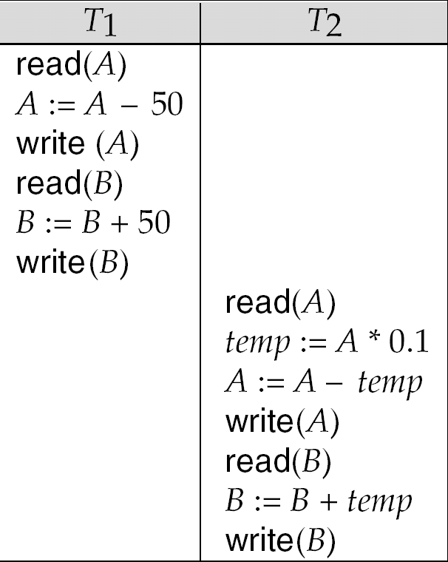
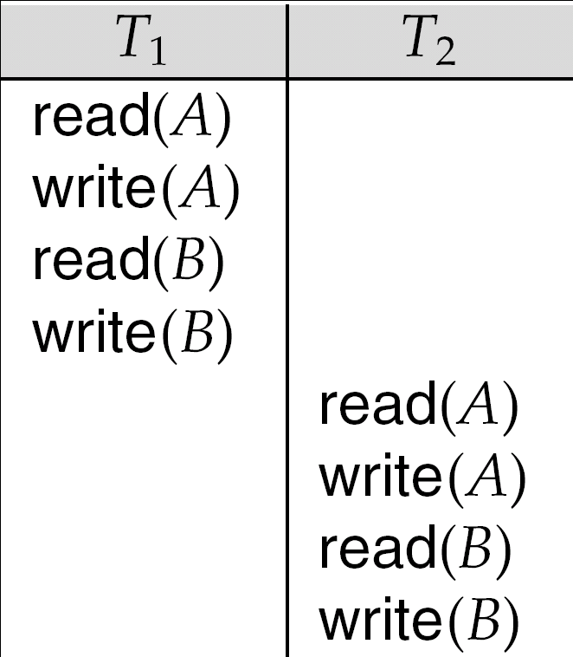

Slide 3
Conflicting Instructions
Instructions l_{i} and l_{j} of transactions T_{i} and T_{j} respectively, conflict if and only if there exists some item Q accessed by both l_{i} and l_{j}, and at least one of these instructions wrote Q.
1. l_{i} = read(Q), l_{j} = read(Q). l_{i} and l_{j} don’t conflict. 2. l_{i} = read(Q), l_{j} = write(Q). They conflict. 3. l_{i} = write(Q), l_{j} = read(Q). They conflict 4. l_{i} = write(Q), l_{j} = write(Q). They conflict
Intuitively, a conflict between l_{i} and l_{j} forces a (logical) temporal order between them.
If l_{i} and l_{j} are consecutive in a schedule and they do not conflict, their results would remain the same even if they had been interchanged in the schedule.

Slide 4
Conflict Serializability
If a schedule S can be transformed into a schedule S´ by a series of swaps of non-conflicting instructions, we say that S and S´ are conflict equivalent.
We say that a schedule S’ is conflict serializable if it is conflict equivalent to a serial schedule

Slide 5
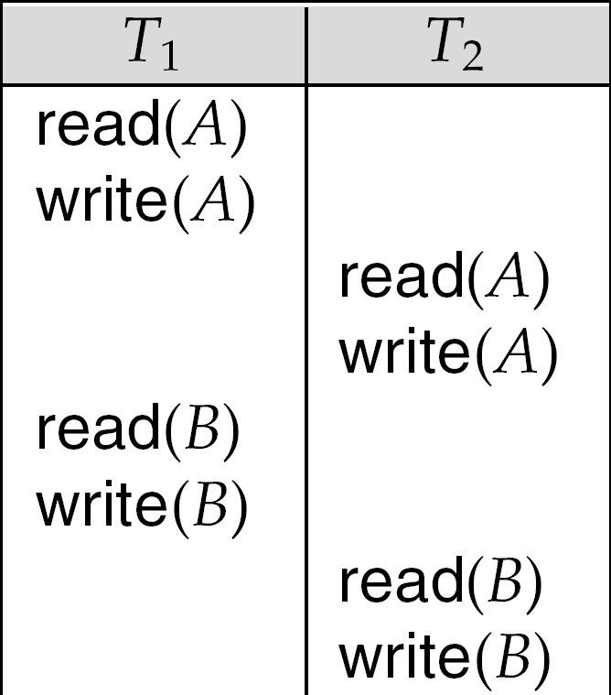
Conflict Serializability
Schedule 3 can be transformed to Schedule 1, a serial schedule where T₂ follows T₁, by series of swaps of non-conflicting instructions.
Therefore Schedule 3 is conflict serializable.
Schedule 3
Schedule 1

Slide 6
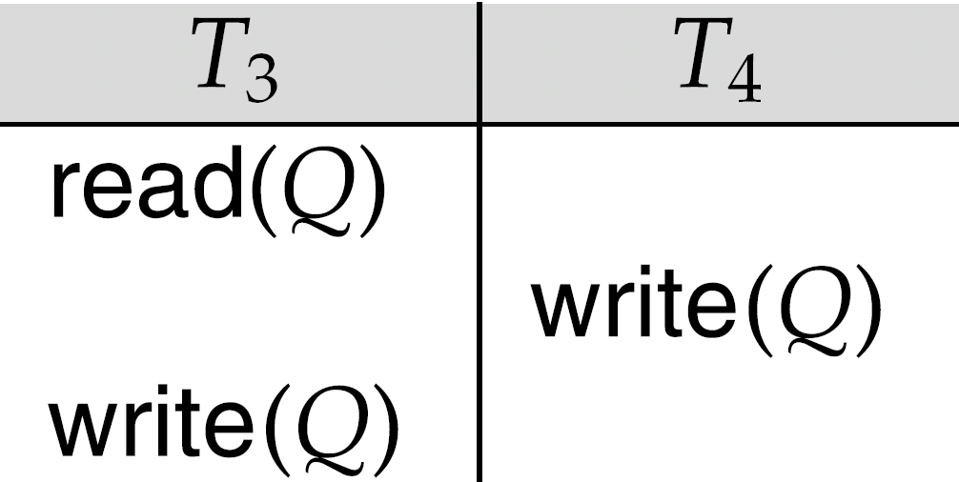
Conflict Serializability (Cont.)
:

Slide 7
Conflict Serializability (Cont.)
Example of a schedule that is not conflict serializable:
We are unable to swap instructions in the above schedule to obtain either the serial schedule < T₃, T₄ >, or the serial schedule < T₄, T₃ >.

Slide 8
View Serializability
Let S and S´ be two schedules with the same set of transactions. S and S´ are view equivalent if the following three conditions are met, for each data item Q,
If in schedule S, transaction T_{i} reads the initial value of Q, then in schedule S’ also transaction T_{i} must read the initial value of Q.
If in schedule S transaction T_{i} executes read(Q), and that value was produced by transaction T_{j} (if any), then in schedule S’ also transaction T_{i} must read the value of Q that was produced by the same write(Q) operation of transaction T_{j} .
The transaction (if any) that performs the final write(Q) operation in schedule S must also perform the final write(Q) operation in schedule S’.
As can be seen, view equivalence is also based purely on reads and writes alone.

Slide 9
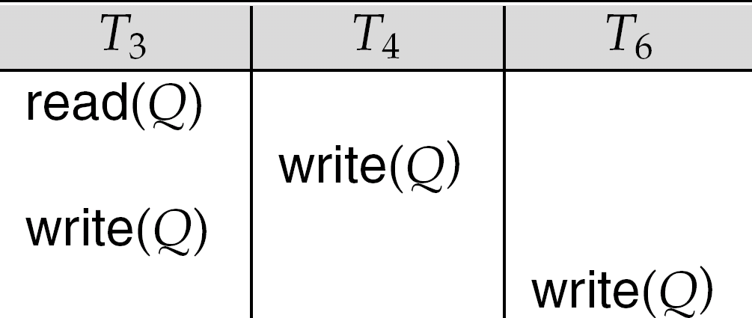
View Serializability (Cont.)
A schedule S is view serializable if it is view equivalent to a serial schedule.
Every conflict serializable schedule is also view serializable.
Which 1?????

Slide 10
View Serializability (Cont.)
A schedule S is view serializable if it is view equivalent to a serial schedule.
Every conflict serializable schedule is also view serializable.
Below is a schedule which is view-serializable but not conflict serializable.
Every view serializable schedule that is not conflict serializable has blind writes.

Slide 11
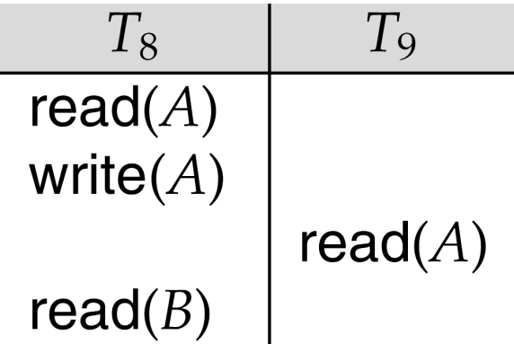
Recoverable Schedules
Need to address the effect of transaction failures on concurrently running transactions.
Recoverable schedule — if a transaction T_{j} reads a data item previously written by a transaction T_{i} , then the commit operation of T_{i} appears before the commit operation of T_{j}.
Schedule 10
If T₈ should abort, T₉ would have read an inconsistent database state. Hence, database must ensure that schedules are recoverable.
The following schedule (Schedule 10) is not recoverable if T₉ commits immediately after the read

Slide 12
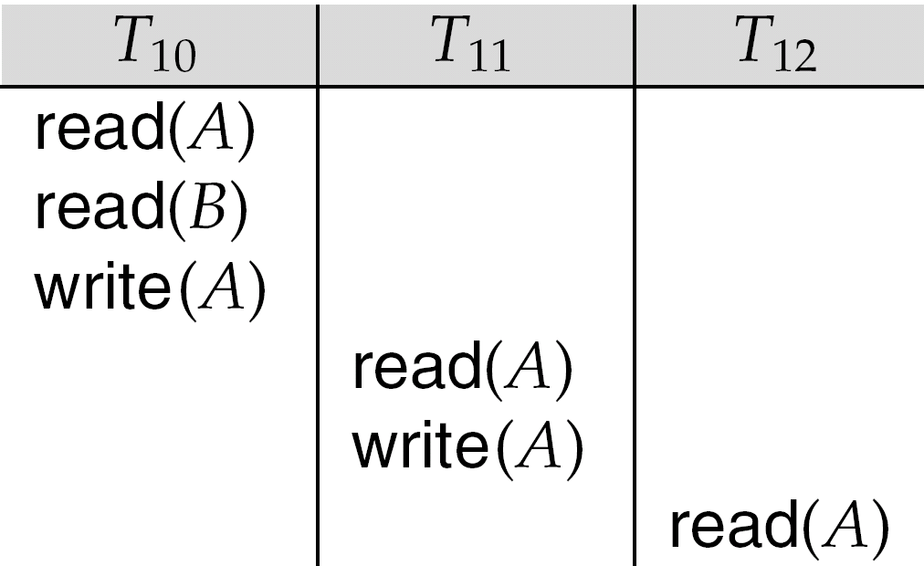
Cascading Rollbacks
Cascading rollback – a single transaction failure leads to a series of transaction rollbacks. Consider the following schedule where none of the transactions has yet committed (so the schedule is recoverable)
If T₁₀ fails, T₁₁ and T₁₂ must also be rolled back.
Can lead to the undoing of a significant amount of work

Slide 13
Cascadeless Schedules
Cascadeless schedules — cascading rollbacks cannot occur; for each pair of transactions T_{i} and T_{j} such that T_{j} reads a data item previously written by T_{i}, the commit operation of T_{i} appears before the read operation of T_{j}.
Every cascadeless schedule is also recoverable
It is desirable to restrict the schedules to those that are cascadeless

Slide 14
University Paper Questions
1.What is serializibility? Explain conflict
Serializibility with suitable example.(1)
2. Explain distinct between the terms serial
schedule and serializable schedule with suitable example. (2) (3)

Slide 15
University Paper Question
3. Check whether given schedule is view serializable. Justify your answer.(4)
4.What is serializable schedule? Explain Conflict & view serializable schedule. (6)

Slide 16
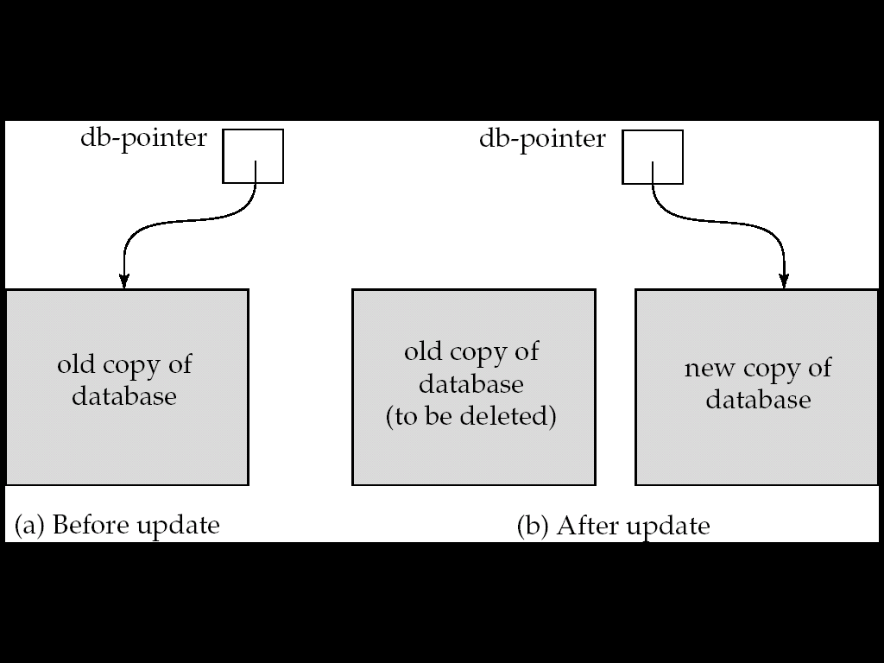
Implementation of Atomicity and Durability
The recovery-management component of a database system implements the support for atomicity and durability.
E.g. the shadow-Copy scheme:
all updates are made on a shadow copy of the database
db_pointer is made to point to the updated shadow copy after
the transaction reaches partial commit and
all updated pages have been flushed to disk.

Slide 17
Implementation of Atomicity and Durability (Cont.)
db_pointer always points to the current consistent copy of the database.
In case transaction fails, old consistent copy pointed to by db_pointer can be used, and the shadow copy can be deleted.
The shadow-copy scheme:
Assumes that only one transaction is active at a time.
Assumes disks do not fail
Useful for text editors, but
extremely inefficient for large databases
Variant called shadow paging reduces copying of data, but is still not practical for large databases
Does not handle concurrent transactions

Slide 18
Implementation of Isolation
Schedules must be conflict or view serializable, and recoverable, for the sake of database consistency, and preferably cascadeless.
A policy in which only one transaction can execute at a time generates serial schedules, but provides a poor degree of concurrency.
Concurrency-control schemes tradeoff between the amount of concurrency they allow and the amount of overhead that they incur.
Some schemes allow only conflict-serializable schedules to be generated, while others allow view-serializable schedules that are not conflict-serializable.

Slide 19
Testing for Serializability
simple and efficient method for determining conflict serializability of a schedule.
Consider a schedule S. We construct a directed graph, called a precedence graph, from S.
This graph consists of a pair G = (V, E), where V is a set of vertices and E is a set of edges.
The set of vertices consists of all the transactions participating in the schedule.
The set of edges consists of all edges Ti →Tj for which
one of three conditions holds:
1. Ti executes write(Q) before Tj executes read(Q).
2. Ti executes read(Q) before Tj executes write(Q).
3. Ti executes write(Q) before Tj executes write(Q).
If an edge Ti → Tj exists in the precedence graph, then, in any serial schedule S equivalent to S, Ti must appear before Tj .

Slide 20
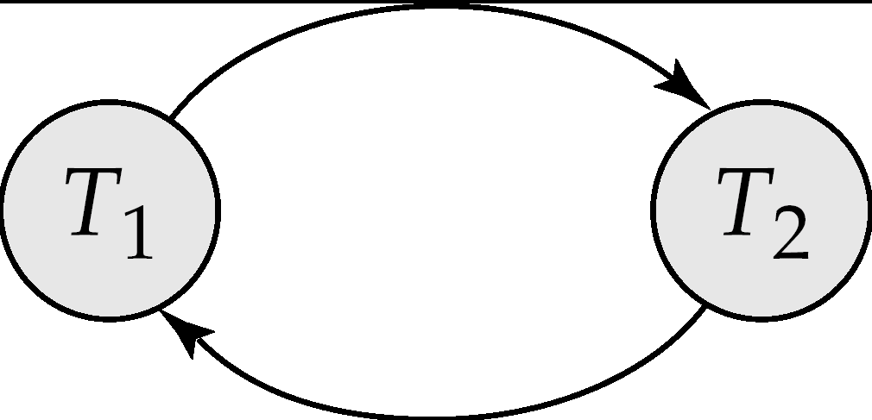
Testing for Serializability
Consider some schedule of a set of transactions T₁, T₂, ..., T_{n}
Precedence graph — a direct graph where the vertices are the transactions (names).
We draw an arc from T_{i} to T_{j} if the two transaction conflict, and T_{i} accessed the data item on which the conflict arose earlier.
We may label the arc by the item that was accessed.
Example 1
x
y

Slide 21
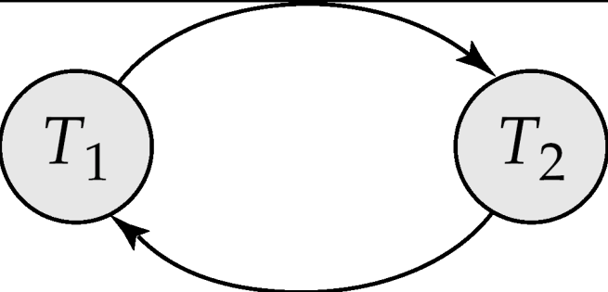
Testing for Serializability
If the precedence graph for S has a cycle, then schedule S is not conflict serializable.
If the graph contains no cycles, then the schedule S is conflict serializable.
Example 1
x
y

Slide 22
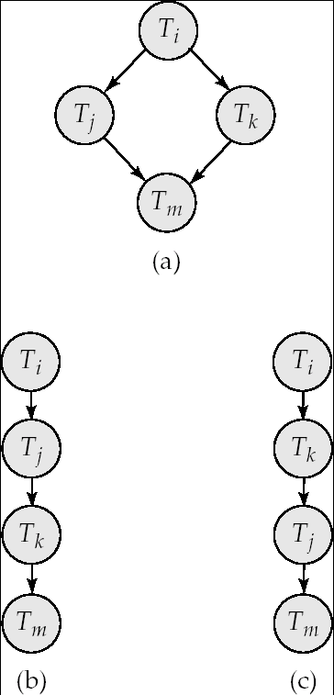
Test for Conflict Serializability
Cycle-detection algorithms exist which take order n² time, where n is the number of vertices in the graph.
(Better algorithms take order n + e where e is the number of edges.)
If precedence graph is acyclic, the serializability order can be obtained by a topological sorting of the graph.
This is a linear order consistent with the partial order of the graph.

Slide 23
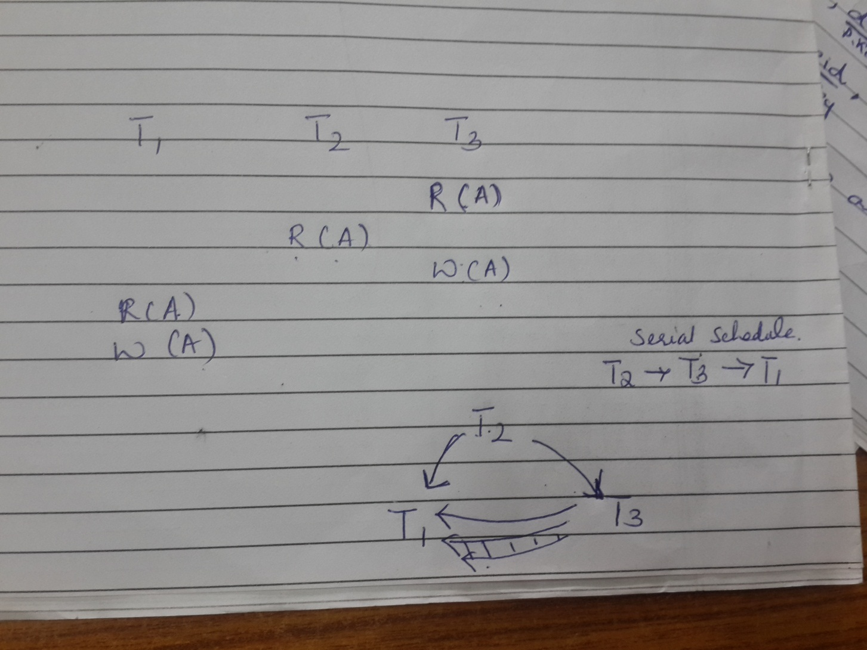
Try

Slide 24
Example Schedule (Schedule A) + Precedence Graph
T₁ T₂ T₃ T₄ T₅ read(X) read(Y) read(Z) read(V) read(W) read(W) read(Y) write(Y) write(Z) read(U) read(Y) write(Y) read(Z) write(Z)
read(U) write(U)

Slide 25
Example Schedule (Schedule A) + Precedence Graph
T₁ T₂ T₃ T₄ T₅ read(X) read(Y) read(Z) read(V) read(W) read(W) read(Y) write(Y) write(Z) read(U) read(Y) write(Y) read(Z) write(Z)
read(U) write(U)
T₁
T₂
T₄
T₃
T₅
For example, a serializability order for Schedule A would be T₅ → T₁ → T₃ → T₂ → T₄

